Slide 1
Gain-Loss Directions
12/6/23

Slide 2
3 Main Points for the Paper
Just as in gains, attention in losses is still over-weighting the “information” about the attended item, which pulls choices towards the attended item.
But when we talk about “information”, we mean a transformation of value that unfolds in two stages: reframing depending on the context (e.g. gains versus losses), then range normalization (Thomas et al. 2019 do a form of this using logistic transformations in the GLAM, which is just range normalization with additional sensitivity to changes when relative evidence is close to 0).
Additive and multiplicative effects of attention on choice need not be mutually exclusive. Incorporating both into one model can capture time-dependent shifts in the mapping from attention to choice (Kovach et al. 2014; Sepulveda et al. 2020).

Slide 3
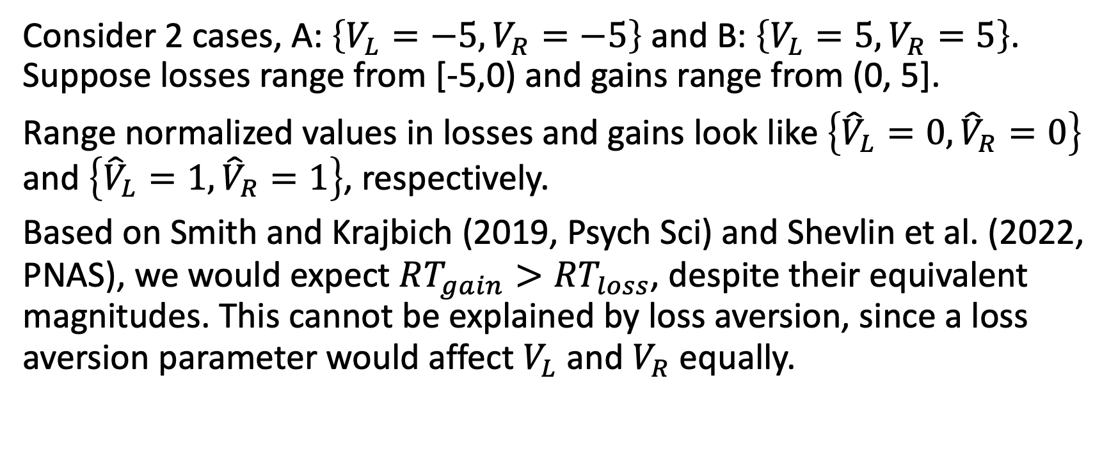
There’s a problem with range normalization.
Consider 2 cases, A: $\left\{V_{L}=−5, V_{R}=−5\right\}$ and B: $\left\{V_{L}=5, V_{R}=5\right\}$. Suppose losses range from [-5,0) and gains range from (0, 5].
Range normalized values in losses and gains look like $\left\{{\hat{V}}_{L}=0, {\hat{V}}_{R}=0\right\}$ and $\left\{{\hat{V}}_{L}=1, {\hat{V}}_{R}=1\right\}$, respectively.
Based on Smith and Krajbich (2019, Psych Sci) and Shevlin et al. (2022, PNAS), we would expect $RT_{gain}>RT_{loss}$, despite their equivalent magnitudes. This cannot be explained by loss aversion, since a loss aversion parameter would affect $V_{L}$ and $V_{R}$ equally.

Slide 4

This problem is only partly alleviated by adding an attentional constant.
WLOG, fixate left. Set drift as
$$μ_{t}=\left({\hat{V}}_{L}+k\right)−θ\left({\hat{V}}_{R}+k\right)$$
WLOG, $θ=\frac{1}{2}$. Set $k=1$.

